Slide 1
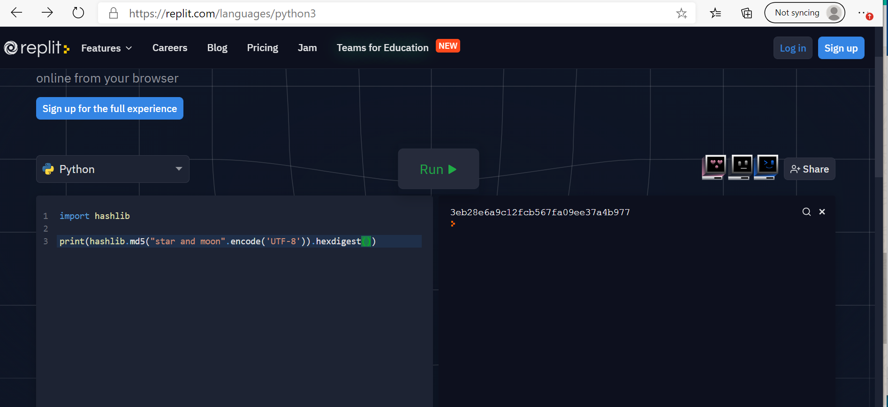
PROJECT WORK
NAME : KAVYADHARSHINI D
EMAIL : kavyadamodharan29@gmail.com

Slide 2
(AS I WAS NOT ABLE TO DOWNLOAD SOFTWARE I HAVE TYPED HERE) Also I have provided the screenshot of execution on the first slide and also in the link copy and paste the coding part to see output https://replit.com/languages/python3 1 import hashlib 2 3 print(hashlib.md5(“star and moon".encode ('UTF-8')).hexdigest()) output 3eb28e6a9c12fcb567fa09ee37a4b977

